Slide 1

1z0-808.examcollection.premium.exam.223q
Number: 1z0-808 Passing Score: 800 Time Limit: 120 min File Version: 15.0
1z0-808
Java SE 8 Programmer I Version 15.0

Slide 2
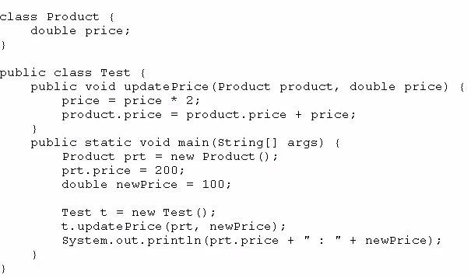
Exam A
QUESTION 1
Given:
What is the result?
A. 200.0 : 100.0
B. 400.0 : 200.0
C. 400.0 : 100.0
D. Compilation fails.
Correct Answer: C Section: (none) Explanation
Explanation/Reference:
QUESTION 2
Which statement is true about the switch statement?
It must contain the default section.
The break statement, at the end of each case block, is optional.
Its case label literals can be changed at runtime.
Its expression must evaluate to a collection of values.
Correct Answer: B Section: (none) Explanation
Explanation/Reference:

Slide 3
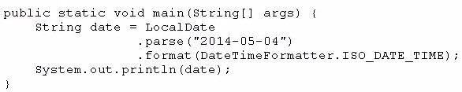
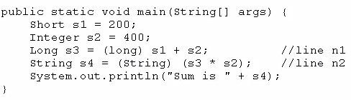
QUESTION 3
Given the code fragment:
What is the result?
A. May 04, 2014T00:00:00.000
B. 2014-05-04T00:00: 00.000
C. 5/4/14T00:00:00.000
D. An exception is thrown at runtime.
Correct Answer: B → D Section: (none) Explanation
Explanation/Reference:
QUESTION 4
Given the code fragment:
What is the result?
Sum is 600
Compilation fails at line n1.
Compilation fails at line n2.
A ClassCastException is thrown at line n1.
A ClassCastException is thrown at line n2.
Correct Answer: C Section: (none) Explanation
Explanation/Reference:
QUESTION 5
What is the name of the Java concept that uses access modifiers to protect variables and hide them within a

Slide 4
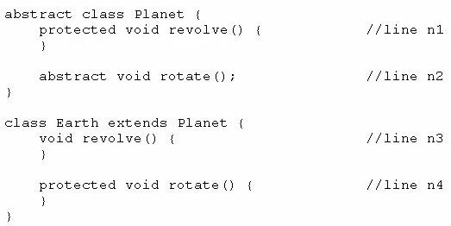
class?
Encapsulation
Inheritance
Abstraction
Instantiation
Polymorphism
Correct Answer: A Section: (none) Explanation
Explanation/Reference:
Explanation:
Using the private modifier is the main way that an object encapsulates itself and hide data from the outside world.
Reference: http://www.tutorialspoint.com/java/java_access_modifiers.htm
QUESTION 6
Given the code fragment:
Which two modifications, made independently, enable the code to compile? (Choose two.)
Make the method at line n1 public.
Make the method at line n2 public.
Make the method at line n3 public.
Make the method at line n3 protected.
Make the method at line n4 public.
Correct Answer: CD Section: (none) Explanation
Explanation/Reference:
QUESTION 7
Given:

Slide 5
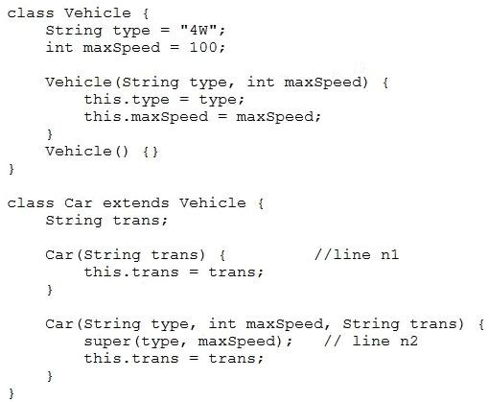
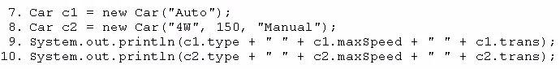
And given the code fragment:
What is the result?
4W 100 Auto 4W 150 Manual
null 0 Auto 4W 150 Manual
Compilation fails only at line n1
Compilation fails only at line n2
Compilation fails at both line n1 and line n2
Correct Answer: E Section: (none) Explanation
Explanation/Reference:
QUESTION 8
Given:

Slide 6
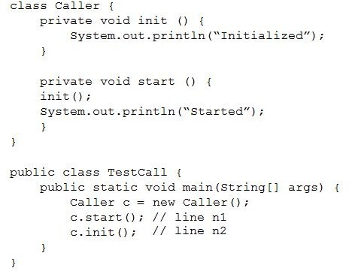
What is the result?
Compilation fails at line n1.
Initialized Started Initialized
Initialized Started
Compilation fails at line n2.
Correct Answer: A Section: (none) Explanation
Explanation/Reference:
QUESTION 9
Given these two classes:

Slide 7
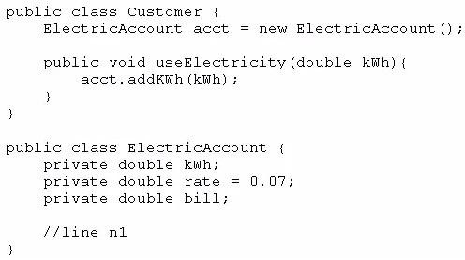
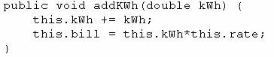
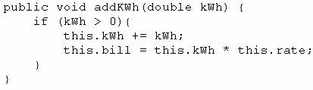
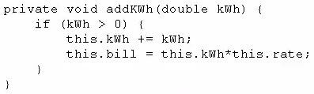
Any amount of electricity used by a customer (represented by an instance of the Customer class) must contribute to the customer's bill (represented by the member variable bill) through the useElectricity method.
An instance of the Customer class should never be able to tamper with or decrease the value of the member variable bill.
How should you write methods in the ElectricAccount class at line n1 so that the member variable
bill is always equal to the value of the member variable kwh multiplied by the member variable rate?
A.
B.
C.

Slide 8
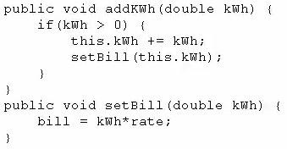
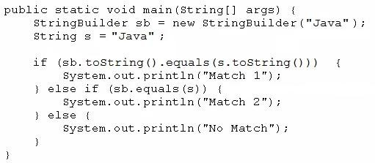
D.
Correct Answer: A → B
Section: (none) Explanation
Explanation/Reference:
QUESTION 10
Given the code fragment:
What is the result?
Match 1
Match 2
No Match
A NullPointerException is thrown at runtime.
Correct Answer: A Section: (none) Explanation
Explanation/Reference:
QUESTION 11
Given:

Slide 9
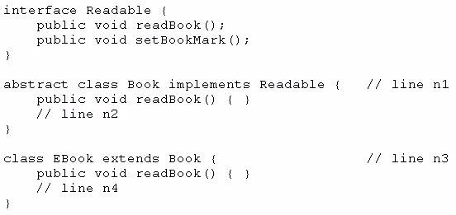
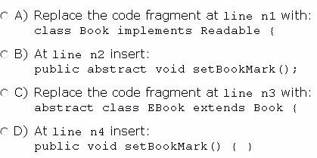
And given the code fragment:
Book book1 = new EBook(); book1.readBook();
Which option enables the code to compile?
Option A
Option B
Option C
Option D
Correct Answer: D Section: (none) Explanation
Explanation/Reference:
QUESTION 12
Given:

Slide 10
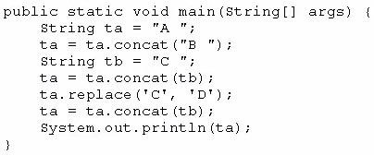
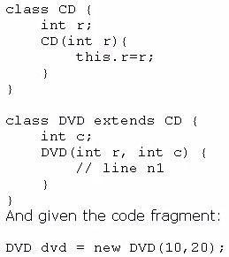
What is the result?
A B C D
A C D
A C D D
A B D
A B D C
A B C C
Correct Answer: C → F
Section: (none) Explanation
Explanation/Reference:
QUESTION 13
Given:
Which code fragment should you use at line n1 to instantiate the dvd object successfully?

Slide 11
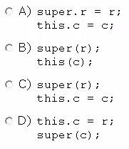
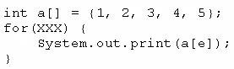
Option A
Option B
Option C
Option D
Correct Answer: C Section: (none) Explanation
Explanation/Reference:
QUESTION 14
Given the code fragment:
Which option can replace xxx to enable the code to print 135?
A.
B.
C.
D.
Correct Answer: B Section: (none) Explanation
Explanation/Reference:
QUESTION 15
Which statement best describes encapsulation?
A. Encapsulation ensures that classes can be designed so that only certain fields and methods of an object

Slide 12
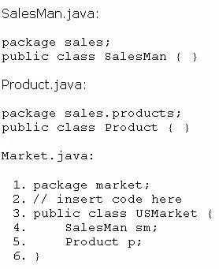
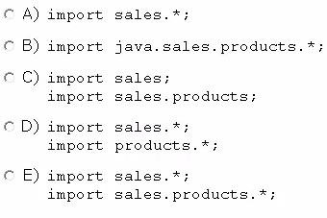
are accessible from other objects.
Encapsulation ensures that classes can be designed so that their methods are inheritable.
Encapsulation ensures that classes can be designed with some fields and methods declared as abstract.
Encapsulation ensures that classes can be designed so that if a method has an argument MyType x, any subclass of MyType can be passed to that method.
Correct Answer: A Section: (none) Explanation
Explanation/Reference:
QUESTION 16
Given the code fragment from three files:
Which code fragment, when inserted at line 2, enables the code to compile?

Slide 13
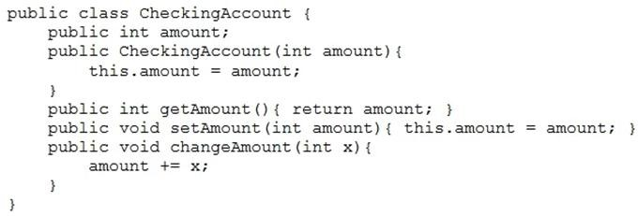
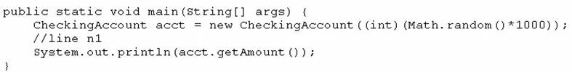
Option A
Option B
Option C
Option D
Option E
Correct Answer: E Section: (none) Explanation
Explanation/Reference:
QUESTION 17
Given this class:
And given this main method, located in another class:
Which three lines, when inserted independently at line n1, cause the program to print a 0 balance? (Choose three.)
acct.setAmount(-acct.getAmount());
acct.amount = 0; <option D earlier>
acct.setAmount(0);
acct.getAmount() = 0; <option E earlier>
this.amount = 0; <option A earlier>
acct.changeAmount(0); <option F earlier>
acct.changeAmount(-acct.amount); <option G earlier>
Correct Answer: BDF -> BCG
Section: (none) Explanation
Explanation/Reference:

Slide 14
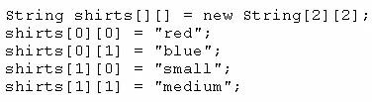
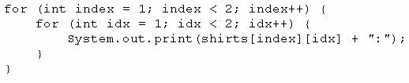
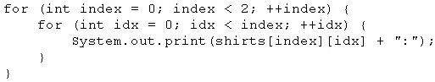
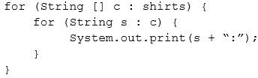
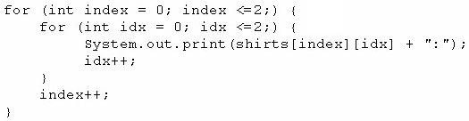
QUESTION 18
Given the code fragment:
Which code fragment prints red:blue:small:medium?
A.
B.
C.
D.
Correct Answer: D → C
Section: (none) Explanation
Explanation/Reference:
QUESTION 19
Given the code fragment:

Slide 15
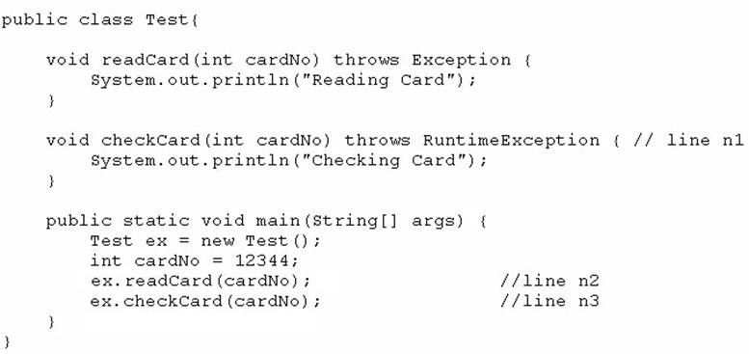
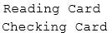
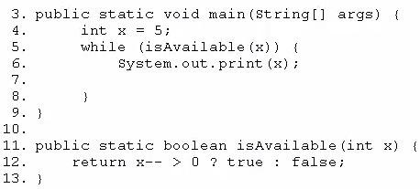
What is the result?
A.
Compilation fails only at line n1.
Compilation fails only at line n2.
Compilation fails only at line n3.
Compilation fails at both line n2 and line n3.
Correct Answer: D → C
Section: (none) Explanation
Explanation/Reference:
QUESTION 20
Given the code fragment:
Which modification enables the code to print 54321?
A. Replace line 6 with System.out. print (--x) ;

Slide 16
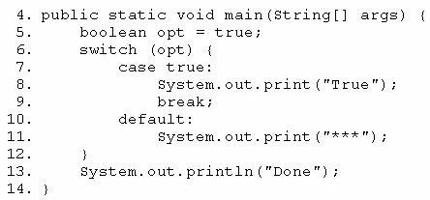
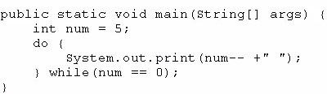
At line 7, insert x --;
Replace line 6 with --x; and, at line 7, insert System.out.print (x);
Replace line 12 with return (x > 0) ? false: true;
Correct Answer: B Section: (none) Explanation
Explanation/Reference:
QUESTION 21
Given the code fragment:
Which modification enables the code fragment to print TrueDone?
Replace line 5 With String opt = "true"; Replace line 7 with case "true":
Replace line 5 with boolean opt = l; Replace line 7 with case 1:
At line 9, remove the break statement.
Remove the default section.
Correct Answer: A Section: (none) Explanation
Explanation/Reference:
QUESTION 22
Given the following main method:

Slide 17
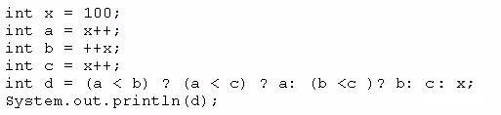
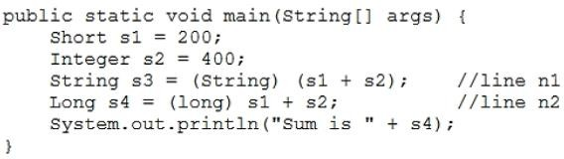
What is the result?
A. 5 4 3 2 1 0
B. 5 4 3 2 1
C. 4 2 1
5
Nothing is printed
Correct Answer: D Section: (none) Explanation
Explanation/Reference:
QUESTION 23
Given the code fragment:
What is the result?
A. 100
B. 101
C. 102
D. 103
E. Compilation fails
Correct Answer: A Section: (none) Explanation
Explanation/Reference:
QUESTION 24
Given the code fragment:

Slide 18
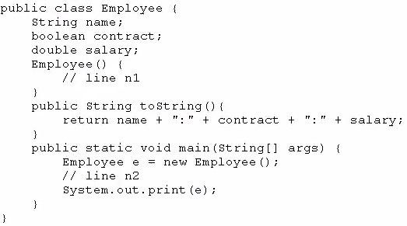
What is the result?
Sum is 600
Compilation fails at line n1.
Compilation fails at line n2.
A ClassCastException is thrown at line n1.
A ClassCastException is thrown at line n2.
Correct Answer: E → B
Section: (none) Explanation
Explanation/Reference:
QUESTION 25
Given the code fragment:
Which two modifications, when made independently, enable the code to print joe:true: 100.0? (Choose two.)

Slide 19
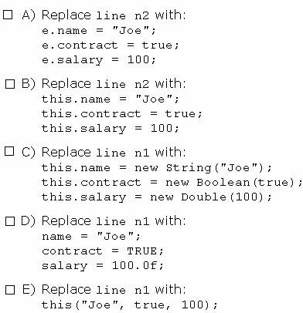
Option A
Option B
Option C
Option D
Option E
Correct Answer: AC Section: (none) Explanation
Explanation/Reference:
QUESTION 26
Given the code fragment:

Slide 20
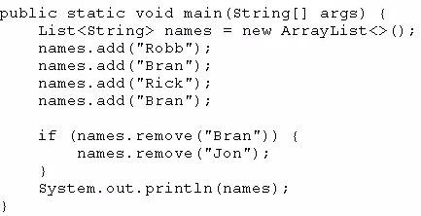
What is the result?
[Robb, Rick, Bran]
[Robb, Rick]
[Robb, Bran, Rick, Bran]
An exception is thrown at runtime.
Correct Answer: A Section: (none) Explanation
Explanation/Reference:
QUESTION 27
Given:

Slide 21
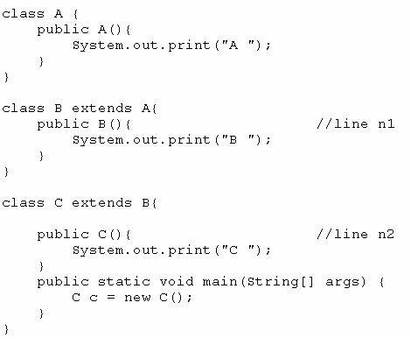
What is the result?
C B A
C
A B C
Compilation fails at line n1 and line n2
Correct Answer: C Section: (none) Explanation
Explanation/Reference:
QUESTION 28
Given:

Slide 22
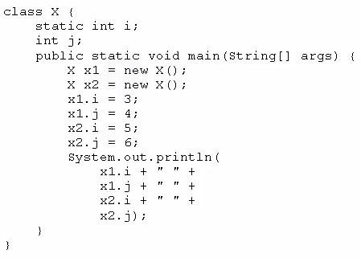
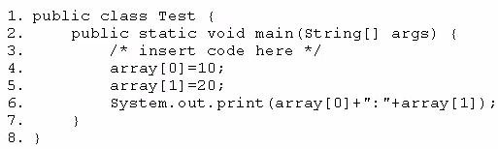
What is the result?
A. 3 4 5 6
B. 3 4 3 6
C. 5 4 5 6
D. 3 6 4 6
Correct Answer: C Section: (none) Explanation
Explanation/Reference:
QUESTION 29
Given the code fragment:
Which code fragment, when inserted at line 3, enables the code to print 10:20?
A.

Slide 23
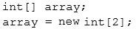
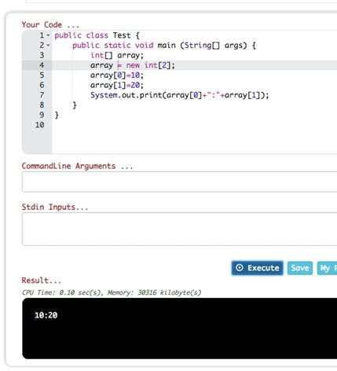
B.
C.
D.
Correct Answer: B Section: (none) Explanation
Explanation/Reference: Explanation:
QUESTION 30
Given the code fragment:

Slide 24
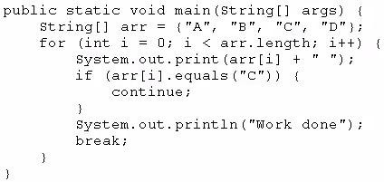
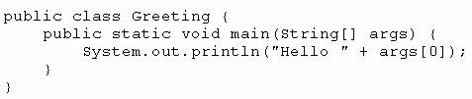
What is the result?
A B C Work done
A B C D Work done
A Work done
Compilation fails
Correct Answer: C Section: (none) Explanation
Explanation/Reference:
QUESTION 31
Which three are advantages of the Java exception mechanism? (Choose three.)
Improves the program structure because the error handling code is separated from the normal program function
Provides a set of standard exceptions that covers all possible errors
Improves the program structure because the programmer can choose where to handle exceptions
Improves the program structure because exceptions must be handled in the method in which they occurred
Allows the creation of new exceptions that are customized to the particular program being created
Correct Answer: ACE Section: (none) Explanation
Explanation/Reference:
Reference: http://javajee.com/introduction-to-exceptions-in-java
QUESTION 32
Given the code from the Greeting.Java file:

Slide 25
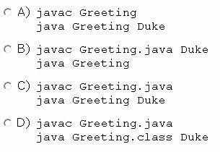
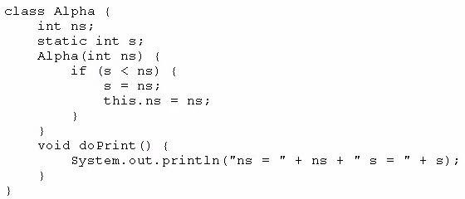
Which set of commands prints Hello Duke in the console?
Option A
Option B
Option C
Option D
Correct Answer: C Section: (none) Explanation
Explanation/Reference:
QUESTION 33
Given:
And:

Slide 26
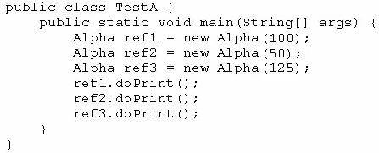
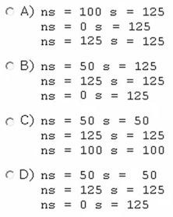
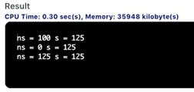
What is the result?
Option A
Option B
Option C
Option D
Correct Answer: A Section: (none) Explanation
Explanation/Reference: Explanation:
QUESTION 34
Given the code fragment:

Slide 27




What is the result?
A. 2 4
B. 0 2 4 6
C. 0 2 4
D. Compilation fails
Correct Answer: C Section: (none) Explanation
Explanation/Reference:
QUESTION 35
Given the code fragment:
Assume that the system date is June 20, 2014. What is the result?
A.
B.
Compilation fails.
An exception is thrown at runtime.
Correct Answer: A → D
Section: (none) Explanation
Explanation/Reference:
QUESTION 36
Given the code fragment:

Slide 28


Which code fragment, when inserted at line 9, enables the code to print true?
String str2 = str1;
String str2 = new String(str1);
String str2 = sb1. toString();
String str2 = "Duke";
Correct Answer: A Section: (none) Explanation
Explanation/Reference:
QUESTION 37
Given:
What is the result?
Compilation fails.
false true
true false
true true
false false
Correct Answer: B Section: (none) Explanation
Explanation/Reference:

Slide 29


QUESTION 38
Given the code fragment:
And given the requirements:
If the value of the qty variable is greater than or equal to 90, discount = 0.5
If the value of the qty variable is between 80 and 90, discount = 0.2
Which two code fragments can be independently placed at line n1 to meet the requirements? (Choose two.)
Option A
Option B
Option C
Option D
Option E
Correct Answer: AC Section: (none) Explanation
Explanation/Reference:
QUESTION 39
Given:

Slide 30


And given the commands:
What is the result?
Success
Failure
Compilation fails.
An exception is thrown at runtime
Correct Answer: A Section: (none) Explanation
Explanation/Reference:
QUESTION 40
Which three statements describe the object-oriented features of the Java language? (Choose three.)
Objects can be reused.
A subclass must override the methods from a superclass.
Objects can share behaviors with other objects.
A package must contain a main class.
Object is the root class of all other objects.
A main method must be declared in every class.
Correct Answer:
BCF → ACE
Section: (none) Explanation
Explanation/Reference:
Reference: http://www.javaworld.com/article/2075459/java-platform/java-101--object-oriented-language- basics--part-5--object-and-its-methods.html (see the sub title, Object is root of all classes not all other objects)
QUESTION 41
Given the following code:

Slide 31


What is the output?
4 4
3 5
4 7
5 4
4 5
4 21
Correct Answer: E Section: (none) Explanation
Explanation/Reference:
QUESTION 42
You are developing a banking module. You have developed a class named ccMask that has a maskcc method.
Given the code fragment:
You must ensure that the maskcc method returns a string that hides all digits of the credit card number except the four last digits (and the hyphens that separate each group of four digits).
Which two code fragments should you use at line n1, independently, to achieve this requirement? (Choose two.)

Slide 32


Option A
Option B
Option C
Option D
Correct Answer: BC Section: (none) Explanation
Explanation/Reference:
QUESTION 43
Given:
Acc.java:
Which statement is true?
A. Both p and s are accessible via obj.

Slide 33

Only s is accessible via obj.
Both r and s are accessible via obj.
p, r, and s are accessible via obj.
Correct Answer: B Section: (none) Explanation
Explanation/Reference:
QUESTION 44
Given:
What is the result?
A. Base
DerivedA

Slide 34

Base
DerivedB
DerivedB DerivedB
DerivedB DerivedA
A ClassCastException is thrown at runtime.
Correct Answer: C Section: (none) Explanation
Explanation/Reference:
QUESTION 45
Given the code fragment:
What is the result?
Execution terminates in the first catch statement, and Caught a RuntimeException is printed to the console.
Execution terminates in the second catch statement, and Caught an Exception is printed to the console.
A runtime error is thrown in the thread "main".
Execution completes normally, and Ready to use is printed to the console.
The code fails to compile because a throws keyword is required.
Correct Answer: C Section: (none) Explanation
Explanation/Reference:
QUESTION 46
Given:

Slide 35


What is the result?
Option A
Option B
Option C
Option D
Correct Answer: D Section: (none) Explanation
Explanation/Reference:
QUESTION 47
Given the code fragments:

Slide 36

Which code fragment, when inserted at line n1, enables the code to print Hank?
A.
B.
C.
D.
Correct Answer: C Section: (none) Explanation
Explanation/Reference:
QUESTION 48
Given the code fragment:

Slide 37


What is the result?
A B C
A B C D E
A B D E
Compilation fails.
Correct Answer: C Section: (none) Explanation
Explanation/Reference:
QUESTION 49
Given the code fragment:
What is the result?
true true
true false
false false
false true
Correct Answer: C Section: (none) Explanation
Explanation/Reference:
QUESTION 50
Given the code fragment:

Slide 38



Which code fragment, when inserted at line n1, enables the App class to print Equal?
Option A
Option B
Option C
Option D
Correct Answer: B Section: (none) Explanation
Explanation/Reference:
QUESTION 51
Given the code fragment:
What is the result?

Slide 39


A. 1 2 3 4
followed by an ArrayIndexOutOfBoundsException
B. 1 2 3
C. 1 2 3 4
D. Compilation fails.
Correct Answer: B → A
Section: (none) Explanation
Explanation/Reference: Explanation:
QUESTION 52
Given the code fragment:
What is the result?
Element 0 Element 1
Null element 0 Null element 1
Null
Null
A NullPointerException is thrown at runtime.
Correct Answer: D Section: (none) Explanation
Explanation/Reference:
QUESTION 53
Given:

Slide 40

What is the result?
A. 10:20
B. 0:20
Compilation fails at line n1
Compilation fails at line n2
Correct Answer: D Section: (none) Explanation
Explanation/Reference:
QUESTION 54
Given the definitions of the MyString class and the Test class:

Slide 41



What is the result?
A.
B.
C.
D. Compilation fails at the Test class Correct Answer: C
Section: (none) Explanation
Explanation/Reference:
QUESTION 55
Given the code fragment:

Slide 42

Which three lines fail to compile? (Choose three.)
Line 7
Line 8
Line 9
Line 10
Line 11
Line 12
Correct Answer: ADF → BCE
Section: (none) Explanation
Explanation/Reference:
QUESTION 56
Given:

Slide 43



What is the result?
int main 1
Object main 1
String main 1
Compilation fails
An exception is thrown at runtime
Correct Answer: D → C
Section: (none) Explanation
Explanation/Reference:
QUESTION 57
Given the code fragment:
Which option represents the state of the num array after successful completion of the outer loop?
A.

Slide 44



B.
C.
D.
Correct Answer: A Section: (none) Explanation
Explanation/Reference:
QUESTION 58
Given this code for a Planet object:

Slide 45





What is the output?
A.
B.
C.
D.

Slide 46






E.
Correct Answer:
C → B
Section: (none) Explanation
Explanation/Reference:
QUESTION 59
You are asked to develop a program for a shopping application, and you are given this information:
The application must contain the classes Toy, EduToy, and ConsToy. The Toy class is the superclass of the other two classes.
The int calculatePrice (Toy t) method calculates the price of a toy. The void printToy (Toy t) method prints the details of a toy.
Which definition of the Toy class adds a valid layer of abstraction to the class hierarchy? A.
B.
C.
D.
Correct Answer: A Section: (none) Explanation
Explanation/Reference:
QUESTION 60
Given the following code:
What are the values of each element in intArr after this code has executed?

Slide 47






A. 15, 60, 45, 90, 75
B. 15, 90, 45, 90, 75
C. 15, 30, 75, 60, 90
D. 15, 30, 90, 60, 90
E. 15, 4, 45, 60, 90
Correct Answer: C Section: (none) Explanation
Explanation/Reference:
QUESTION 61
Given this array:
Which two code fragments, independently, print each element in this array? (Choose two.)
A.
B.
C.
D.
E.
F.
Correct Answer: BE Section: (none) Explanation
Explanation/Reference:
QUESTION 62
Given the content of three files:

Slide 48

Which statement is true?
Only the A.Java file compiles successfully.
Only the B.java file compiles successfully.
Only the C.java file compiles successfully.
The A.Java and B.java files compile successfully.
The B.java and C.java files compile successfully.
The A.Java and C.java files compile successfully.
Correct Answer: A Section: (none) Explanation
Explanation/Reference:
QUESTION 63
Given the code fragment:
And given the requirements:
Process all the elements of the array in the order of entry.
Process all the elements of the array in the reverse order of entry.
Process alternating elements of the array in the order of entry.

Slide 49

Which two statements are true? (Choose two.)
Requirements 1, 2, and 3 can be implemented by using the enhanced for loop.
Requirements 1, 2, and 3 can be implemented by using the standard for loop.
Requirements 2 and 3 CANNOT be implemented by using the standard for loop.
Requirement 1 can be implemented by using the enhanced for loop.
Requirement 3 CANNOT be implemented by using either the enhanced for loop or the standard for loop.
Correct Answer:
DE → BD
Section: (none) Explanation
Explanation/Reference:
QUESTION 64
Given:
What is the result?
A. 400 200
B. 200 200
C. 400 400
D. Compilation fails.
Correct Answer: A Section: (none) Explanation
Explanation/Reference:
QUESTION 65
Given the following class declarations: public abstract class Animal
public interface Hunter
public class Cat extends Animal implements Hunter public class Tiger extends Cat
Which answer fails to compile?

Slide 50

Option A
Option B
Option C
Option D
Option E
Correct Answer:
E → D
Section: (none) Explanation
Explanation/Reference:
QUESTION 66
Which statement is true about Java byte code?
It can run on any platform.
It can run on any platform only if it was compiled for that platform.
It can run on any platform that has the Java Runtime Environment.
It can run on any platform that has a Java compiler.
It can run on any platform only if that platform has both the Java Runtime Environment and a Java compiler.
Correct Answer:
D → C
Section: (none) Explanation
Explanation/Reference:
Explanation:
Java bytecodes help make "write once, run anywhere" possible. You can compile your program into bytecodes on any platform that has a Java compiler. The bytecodes can then be run on any implementation of the Java VM. That means that as long as a computer has a Java VM, the same program written in the Java programming language can run on Windows 2000, a Solaris workstation, or on an iMac.
Reference: http://www.math.uni-hamburg.de/doc/java/tutorial/getStarted/intro/definition.html QUESTION 67
Given:

Slide 51


How many MarkList instances are created in memory at runtime?
1
2
3
4
Correct Answer: A Section: (none) Explanation
Explanation/Reference:
QUESTION 68
Given:

Slide 52

What is the result?
Area is 6.0
Area is 3.0
Compilation fails at line n1
Compilation fails at line n2.
Correct Answer: A Section: (none) Explanation
Explanation/Reference:
QUESTION 69
Given the code fragment:
Which three code fragments can be independently inserted at line n1 to enable the code to print One? (Choose three.)
byte x = 1;
short x = 1;
String x = "1";
long x = 1;
double x = 1;
Integer x = new Integer("1");
Correct Answer: ABF Section: (none) Explanation
Explanation/Reference:
QUESTION 70
Given:

Slide 53


What is the result?
True false
True null
Compilation fails
A NullPointerException is thrown at runtime
Correct Answer: A => B
Section: (none) Explanation
Explanation/Reference:
QUESTION 71
Given the following code for the classes MyException and Test:
What is the result?
A
B
Either A or B
A B

Slide 54

E. A compile time error occurs at line n1
Correct Answer: B Section: (none) Explanation
Explanation/Reference:
QUESTION 72
Given:
What is the result?
myStr: 9009, myNum: 9009
myStr: 7007, myNum: 7007
myStr: 7007, myNum: 9009
Compilation fails
Correct Answer: C Section: (none) Explanation
Explanation/Reference:
QUESTION 73
Which two are benefits of polymorphism? (Choose two.)
A. Faster code at runtime

Slide 55

More efficient code at runtime
More dynamic code at runtime
More flexible and reusable code
Code that is protected from extension by other classes
Correct Answer: BD Section: (none) Explanation
Explanation/Reference:
Reference: https://www.cs.princeton.edu/courses/archive/fall98/cs441/mainus/node5.html
QUESTION 74
Given the code fragment:
What is the result?
A. 1:2:3:4:5:
B. 1:2:3:
Compilation fails.
An ArrayOutOfBoundsException is thrown at runtime.
Correct Answer: B Section: (none) Explanation
Explanation/Reference:
QUESTION 75
Given:

Slide 56

What is the result?
true:true
true:false
false:true
false:false
Correct Answer: C Section: (none) Explanation
Explanation/Reference:
QUESTION 76
Given the following classes:

Slide 57

Which two options fail to compile when placed at line n1 of the main method? (Choose two.)
employee.salary = 50_000;
director.salary = 80_000;
employee.budget = 200_000;
manager.budget = 1_000_000;
manager.stockOption = 500;
director.stockOptions = 1_000;
Correct Answer: CE Section: (none) Explanation
Explanation/Reference:
QUESTION 77
Which one of the following code examples uses valid Java syntax?

Slide 58

Option A
Option B
Option C
Option D
Correct Answer: A Section: (none) Explanation
Explanation/Reference:
Reference: https://docs.oracle.com/javase/tutorial/getStarted/application/
QUESTION 78
Given the code fragment:

Slide 59


What is the result?
A. 1324
B. 2313
C. 3142
D. 4231
E. 2413
Correct Answer: D → E
Section: (none) Explanation
Explanation/Reference:
QUESTION 79
Given:

Slide 60

What is the result?
An exception is thrown at runtime.
Initialized Started Initialized
Initialized Started
Compilation fails.
Correct Answer: D Section: (none) Explanation
Explanation/Reference:
QUESTION 80
Given the code fragment:
What is the result?
Answer = 0
Invalid calculation
Compilation fails only at line n1.
Compilation fails only at line n2.
Compilation fails at line n1 and line2.
Correct Answer: E Section: (none) Explanation
Explanation/Reference:
QUESTION 81
Given:

Slide 61

What is the result?
A. 100 200 : 0 0 :
B. 100 200 : 100 0 :
C. 100 200 : 100 200 :
D. 0 0 : 100 0 :
Correct Answer: B => A Section: (none) Explanation
Explanation/Reference:
QUESTION 82
Given:

Slide 62


What is the result?
a, e
i, i
a, e
o, o
e, e
i, i
a, a
o, o
Correct Answer: A Section: (none) Explanation
Explanation/Reference:
QUESTION 83
Given the code fragment:
What is the result if the integer aVar is 9?
Compilation fails.
10 Hello Universe!
10 Hello World!

Slide 63


D. 9 Hello World!
Correct Answer: B Section: (none) Explanation
Explanation/Reference:
QUESTION 84
Given:
What is the result?
Compilation fails.
11
8
9
10
Correct Answer: B Section: (none) Explanation
Explanation/Reference:
QUESTION 85
Given:
And given the commands:

Slide 64






What is the result?
1 null
true false
false false
true true
A ClassCastException is thrown at runtime.
Correct Answer: D => C Section: (none) Explanation
Explanation/Reference:
QUESTION 86
Given the code fragment:
What is the result?
A. Compilation fails. B.
C.
D.
E.
Correct Answer: E Section: (none) Explanation

Slide 65

Explanation/Reference: Explanation:
QUESTION 87
Which statement will empty the contents of a StringBuilder variable named sb?
sb. deleteAll ();
sb. delete (0, sb. size () );
sb. delete (0, sb. length () );
sb. removeAll ();
Correct Answer: C Section: (none) Explanation
Explanation/Reference:
QUESTION 88
Given:

Slide 66


Which code fragment can replace the if block?
A.
B.
C.
D.
Correct Answer: D Section: (none) Explanation
Explanation/Reference:
QUESTION 89
Given:
And the code fragment:

Slide 67


Which code fragment, when inserted at line 14, enables the code to print Mike Found?
A.
B.
C.
D.
Correct Answer: A Section: (none) Explanation
Explanation/Reference:
QUESTION 90
Which statement is true about the switch statement?
It must contain the default section.
The break statement, at the end of each case block, is mandatory.
Its case label literals can be changed at runtime.
Its expression must evaluate to a single value.
Correct Answer: D Section: (none) Explanation

Slide 68



Explanation/Reference:
Reference: http://www.dummies.com/programming/java/switch-statements-in-java/
QUESTION 91
Given:
And given the code fragment:
and this output:
Canine 60 Long
Feline 80 Short
Which two modifications enable the code to print this output? (Choose two.)
A. . Replace line n1 with:

Slide 69





B. Replace line n1 with:
C. Replace line n2 with:
D. Replace line n1 with:
E. Replace line n2 with:
Correct Answer: AE Section: (none) Explanation
Explanation/Reference:
QUESTION 92
Given the code fragment:
What is the result?

Slide 70




A. Invalid Name
B.
C.
D.
Correct Answer: C Section: (none) Explanation
Explanation/Reference:
QUESTION 93
Given the code fragment:
Test.java

Slide 71



Which is the result?
A. Compilation fails in the Employee class. B.
C.
Compilation fails in the Test class.
Both the Employee class and the Test class fail to compile.
Correct Answer: E Section: (none) Explanation
Explanation/Reference:
QUESTION 94
Given the code fragments:

Slide 72




Which modification enables the code to compile?
A.
B.
C.

Slide 73


D.
Correct Answer: C Section: (none) Explanation
Explanation/Reference:
QUESTION 95
Given:
What is the result?

Slide 74



A B
A C
C C
A ClassCastException is thrown only at line n1.
A ClassCastException is thrown only at line n2.
Correct Answer: B => E Section: (none) Explanation
Explanation/Reference:
QUESTION 96
Given:
What is the result?
A.
B.

Slide 75



C.
D.
Correct Answer: D => B Section: (none) Explanation
Explanation/Reference:
QUESTION 97
You are asked to create a method that accepts an array of integers and returns the highest value from that array.
Given the code fragment:
Which method signature do you use at line n1?
public int findMax (int[] numbers)
static int[] findMax (int[] max)
static int findMax (int[] numbers)
final int findMax (int[] )
Correct Answer: C => B Section: (none) Explanation
Explanation/Reference:
QUESTION 98
Which three statements are true about the structure of a Java class? (Choose three.)
A. A public class must have a main method.

Slide 76





A class can have only one private constructor.
A method can have the same name as a field.
A class can have overloaded static methods.
The methods are mandatory components of a class.
The fields need not be initialized before use.
Correct Answer: ACE
=> CDF Section: (none) Explanation
Explanation/Reference:
QUESTION 99
Given the code fragment:
What is the result?
A.
B.
C.
D.
Correct Answer: D Section: (none) Explanation
Explanation/Reference:
QUESTION 100
Given:

Slide 77

What is the result?
Compilation fails at line n3 and line n4.
Compilation fails at line n1 and line n2.
Welcome Visit Count:1 Welcome Visit Count: 1
Welcome Visit Count:1 Welcome Visit Count: 2
Correct Answer: B Section: (none) Explanation
Explanation/Reference:
QUESTION 101
Given the code fragment:

Slide 78

What is the result?
Compilation fails at both line n1 and line n2.
Compilation fails only at line n2.
Compilation fails only at line n1.
Jesse 25 Walter 52
Correct Answer: A => B Section: (none) Explanation
Explanation/Reference:
QUESTION 102
Given the code fragment:

Slide 79

What is the result?
A. 5 : 5
B. 10 : 10
C. 5 : 10
D. Compilation fails.
Correct Answer: B Section: (none) Explanation
Explanation/Reference: Explanation:

Slide 80


QUESTION 103
Given the code fragment:

Slide 81

What is the result?
A. A NullPointerException is thrown at runtime.
B. [1, 2, 4]
C. [1, 2, 4, null]
D. [1, 3, 4, null]
E. [1, 3, 4]
F. Compilation fails.
Correct Answer: B => E Section: (none) Explanation
Explanation/Reference: Explanation:
QUESTION 104
Given:
What is the result?
A. 10 20 30 40
B. 0 0 30 40
Compilation fails.
An exception is thrown at runtime.
Correct Answer: B Section: (none) Explanation
Explanation/Reference:

Slide 82



QUESTION 105
Which two code fragments cause a compilation error? (Choose two.)
float flt = 100.00F;
float flt = (float) 1_11.00;
Float flt = 100.00;
double y1 = 203.22; float flt = y1;
int y2 = 100;
float flt = (float) y2 ;
Correct Answer: AD => CD Section: (none) Explanation
Explanation/Reference:
QUESTION 106
Given:
What is the result?
A.
B.

Slide 83




C.
D.
Correct Answer: A Section: (none) Explanation
Explanation/Reference:
QUESTION 107
Which three statements are true about exception handling? (Choose three.)
Only unchecked exceptions can be rethrown.
All subclasses of the RuntimeException class are not recoverable.
The parameter in a catch block is of Throwable type.
All subclasses of the RuntimeException class must be caught or declared to be thrown.
All subclasses of the RuntimeException class are unchecked exceptions.
All subclasses of the Error class are not recoverable.
Correct Answer: BCD
=> CEF Section: (none) Explanation
Explanation/Reference:
QUESTION 108
Given the code fragment:
Which code fragment, inserted at line n1, prints The Top element: 30?
A.

Slide 84





B.
C.
D.
E.
Correct Answer: E
=> C Section: (none) Explanation
Explanation/Reference:
QUESTION 109
Given the code fragment:
What is the result?
An exception is thrown at runtime.
-1
5
10
Correct Answer: A
=> C Section: (none) Explanation
Explanation/Reference:
QUESTION 110
Given:

Slide 85

What is the result?
false, false
false, true
true, false
true, true
Correct Answer: C Section: (none) Explanation
Explanation/Reference:
QUESTION 111
Which two statements are true? (Choose two.)
Error class is unextendable.
Error class is extendable.
Error is a RuntimeException.
Error is an Exception.
Error is a Throwable.
Correct Answer: BE Section: (none) Explanation
Explanation/Reference:
QUESTION 112
Given the code fragment:

Slide 86


What is the result?
Compilation fails.
0 Found
1 Found
3 Found
Correct Answer: A Section: (none) Explanation
Explanation/Reference:
QUESTION 113
Given the code fragment:
What is the result?
A. An exception is thrown at runtime.
B. 07-31-2014
C. 2014-07-31
D. 2014-09-30
Correct Answer: A => C Section: (none) Explanation
Explanation/Reference:
QUESTION 114

Slide 87




Given:
And given the commands:
What is the result?
Java SE
Java EE
Compilation fails at line n1.
A NullPointerException is thrown at runtime.
Correct Answer: B => A Section: (none) Explanation
Explanation/Reference:
QUESTION 115
Given this class:
And given this main method, located in another class:

Slide 88






Which three pieces of code, when inserted independently, set the value of amount to 100?
A.
B.
C.
D.
E.
F.
Correct Answer: CDE => ADE Section: (none) Explanation
Explanation/Reference:
QUESTION 116
Given the code fragments:

Slide 89

What is the result?
Compilation fails only at line n2.
RTool::export Tool::export
Tool::export Tool:export
Compilation fails only at line n1.
Compilation fails at both line n1 and line n2.
Correct Answer: B => D Section: (none) Explanation

Slide 90



Explanation/Reference:
QUESTION 117
Given the code fragment:
What is the result?
An exception is thrown at runtime.
Compilation fails.
C. 13480.0
D. 13480.02
Correct Answer: D Section: (none) Explanation
Explanation/Reference:
QUESTION 118
Given:
And given the code fragment:
What is the result?
A. 300:300
200:300
B. 300:100
200:300
C. 300:0

Slide 91


0:300
D. 100:300
300:200
Correct Answer: D Section: (none) Explanation
Explanation/Reference:
QUESTION 119
Given:
And given the code fragment:
What is the result?
C2C2
C1C2
C1C1
Compilation fails

Slide 92


Correct Answer: B => D Section: (none) Explanation
Explanation/Reference:
QUESTION 120
Given:
Given the code fragment:
Which two sets of actions, independently, enable the code fragment to print Fit?
At line n1 insert: import clothing.Shirt;
At line n2 insert: String color = Shirt.getColor();
At line n1 insert: import clothing;
At line n2 insert: String color = Shirt.getColor();
At line n1 insert: import static clothing.Shirt.getColor;
At line n2 insert: String color = getColor();
At line n1 no changes required.
At line n2 insert: String color = Shirt.getColor();
At line n1 insert: import Shirt;
At line n2 insert: String color = Shirt.getColor();
Correct Answer: D => A, C Section: (none) Explanation
Explanation/Reference:

Slide 93


QUESTION 121
Given the code fragments:
And:
Which statement is true?
After line 11, three objects are eligible for garbage collection.
After line 11, two objects are eligible for garbage collection.
After line 11, one object is eligible for garbage collection.
After line 11, none of the objects are eligible for garbage collection.
Correct Answer: C Section: (none) Explanation
Explanation/Reference:
QUESTION 122
Given the code fragment:

Slide 94


What is the result?
3
4
-1
Compilation fails.
Correct Answer: A Section: (none) Explanation
Explanation/Reference:
QUESTION 123
Given the code fragment:
What is the result?
A. 2012-02-10
B. 2012-02-11
Compilation fails
A DateTimeException is thrown at runtime.

Slide 95

Correct Answer: D Section: (none) Explanation
Explanation/Reference:
QUESTION 124
Given:
What is the result?
A. 10 : 30 : 6
B. 10 : 22 : 22
C. 10 : 22 : 20
D. 10 : 22 : 6
Correct Answer: A Section: (none) Explanation
Explanation/Reference: Explanation:
QUESTION 125
Given:

Slide 96


And given the code fragment:
What is the result?
Compilation fails at line n2.
Read Book
Read E-Book
Compilation fails at line n1.
Compilation fails at line n3.
Correct Answer: E Section: (none) Explanation
Explanation/Reference:
QUESTION 126
Given this class:

Slide 97


Which two changes would encapsulate this class and ensure that the area field is always equal to length * height whenever the Rectangle class is used?
Call the setArea method at the end of the setHeight method.
Call the setArea method at the beginning of the setHeight method.
Call the setArea method at the end of the setLength method.
Call the setArea method at the beginning of the setLength method.
Change the setArea method to private.
Change the area field to public.
Correct Answer: AC Section: (none) Explanation
Explanation/Reference:
QUESTION 127
Given the code fragment:

Slide 98




What is the result?
[green, red, yellow, cyan]
[green, blue, yellow, cyan]
[green, red, cyan, yellow]
An IndexOutOfBoundsException is thrown at runtime.
Correct Answer: D => B Section: (none) Explanation
Explanation/Reference:
QUESTION 128
Given the code fragment:
Which three code fragments are valid at line n1? (Choose three.)
A.
B.
C.
D.
E.
Correct Answer: ADE Section: (none) Explanation
Explanation/Reference:
QUESTION 129
Given:

Slide 99


What is the result?
Compilation fails.
3 5
0 0
D. 9 25
Correct Answer: B Section: (none) Explanation
Explanation/Reference:
QUESTION 130
Given the code fragment:
Which two code fragments can be independently inserted at line n1 to enable the code to print the elements of the array in reverse order? (Choose two.)

Slide 100





A.
B.
C.
D.
E.
Correct Answer: AE Section: (none) Explanation
Explanation/Reference:
QUESTION 131
Given:

Slide 101

What is the result?
10 Hello Hello 11
10 Hello Hello 121
100 Hello 121
100 Hello Hello 121
10 Hello 11
Correct Answer: E Section: (none) Explanation
Explanation/Reference:
QUESTION 132
Given the code fragment:

Slide 102





What is the result?
Compilation fails.
Hi removed
An UnsupportedOperationException is thrown at runtime.
The program compiles, but it prints nothing.
Correct Answer: A Section: (none) Explanation
Explanation/Reference:
QUESTION 133
Which two class definitions fail to compile? (Choose two.)
A.
B.
C.
D.

Slide 103


E.
Correct Answer: CD
=> CE Section: (none) Explanation
Explanation/Reference:
QUESTION 134
Given:
What is the result?
null
Richard Donald
Richard Donald
Compilation fails.
An ArrayIndexOutOfBoundsException is thrown at runtime.
A NullPointerException is thrown at runtime.
Correct Answer: E Section: (none) Explanation

Slide 104


Explanation/Reference:
QUESTION 135
This grid shows the state of a 2D array:
The grid is created with this code:
Which line of code, when inserted in place of //line n1, adds an X into the grid so that the grid contains three consecutive XS?
A. grid[2][1] = ‘X’;
B. grid[3][2] = ‘X’;
C. grid[3][1] = ‘X’;
D. grid[2][3] = ‘X’;
Correct Answer: D => A Section: (none) Explanation
Explanation/Reference:
QUESTION 136
Given:

Slide 105


What is the result?
Hello Log 1:0
Hello Log 2:1
Welcome Log 2:1
Welcome Log 1:0
Correct Answer: C Section: (none) Explanation
Explanation/Reference:
QUESTION 137
Given the code snippet from a compiled Java source file:
Which command-line arguments should you pass to the program to obtain the following output?
Arg is 2
java MyFile 1 3 2 2
java MyFile 2 2 2
java MyFile 1 2 2 3 4
java MyFile 0 1 2 3

Slide 106


Correct Answer: A Section: (none) Explanation
Explanation/Reference:
QUESTION 138
Given the code fragment:
Which two modifications should you make so that the code compiles successfully? (Choose two.)
A. Replace line 13 with:
Replace line 7 with throw IOException (“Exception raised”);
Replace line 11 with public static void main(String[]) args) throws Exception {
At line 14, insert throw new IOException();
Replace line 5 with public void printFileContent() throws IOException {
Correct Answer: CE Section: (none) Explanation
Explanation/Reference:
QUESTION 139
Given the code fragment:

Slide 107


What is the result?
A. 1 3 5 7
1 3
1 3 1 3
1 3
1 3 0 0
1 3
followed by an ArrayIndexOutOfBoundsException
Compilation fails.
Correct Answer: B Section: (none) Explanation
Explanation/Reference: Explanation:
QUESTION 140
Given:
MainTest.java:

Slide 108


and commands:
What is the result?
String main 1
An exception is thrown at runtime
String main 1 2 3
String main 123
Correct Answer: A => C Section: (none) Explanation
Explanation/Reference:
QUESTION 141
Which two statements are true about Java byte code? (Choose two.)
It can be serialized across network.
It can run on any platform that has a Java compiler.
It can run on any platform.
It has “.java” extension.
It can run on any platform that has the Java Runtime Environment.
Correct Answer: AE Section: (none) Explanation
Explanation/Reference:
QUESTION 142
Which is true about the switch statement?
Its expression can evaluate to a collection of values.
The break statement, at the end of each case block, is optional.
Its case label literals can be changed at runtime.
It must contain the default section.
Correct Answer: B Section: (none) Explanation

Slide 109


Explanation/Reference:
Reference: https://www.geeksforgeeks.org/switch-statement-in-java/
QUESTION 143
Given the code fragment:
What is the result?
A. 3142
B. 2413
C. 1324
D. 4231
Correct Answer: D Section: (none) Explanation
Explanation/Reference: Explanation:
QUESTION 144
Given:

Slide 110


What is the result?
A. 9 5
B. 81 25
Compilation fails.
0 0
Correct Answer: A Section: (none) Explanation
Explanation/Reference: Explanation:
QUESTION 145
Given this segment of code:

Slide 111

Which two statements, if either were true, would make the code compile? (Choose two.)
MotorCycle is an interface that implements the Cycle class.
Cycle is an interface that is implemented by the MotorCycle class.
Cycle is an abstract superclass of MotorCycle.
Cycle and MotorCycle both extend the Transportation superclass.
Cycle and MotorCycle both implement the Transportation interface.
MotorCycle is a superclass of Cycle.
Correct Answer: BC Section: (none) Explanation
Explanation/Reference:
QUESTION 146
Given the code fragments:
What is the result?
Compilation fails only at line n1.
Compilation fails only at line n2.

Slide 112


Tool::export Tool::export
Compilation fails at both line n1 and line2.
RTool::export Tool::export
Correct Answer: A => B Section: (none) Explanation
Explanation/Reference:
QUESTION 147
Given:
And given the code fragment:
What is the result?
Compilation fails at line n2.
Compilation fails at line n1.
C. 20:20
D. 10:20

Slide 113


Correct Answer: A => C Section: (none) Explanation
Explanation/Reference:
QUESTION 148
Given the code fragment:
What is the result?
A. 2012-02-10 00:00
B. 2012-01-30
C. 2012-02-10
D. A DateTimeException is thrown at runtime.
Correct Answer: B Section: (none) Explanation
Explanation/Reference: Explanation:
QUESTION 149
Given:

Slide 114



What is the result?
Hello Log 2:2
Welcome Log 1:2
Welcome Log 2:1
Hello Log 1:2
Correct Answer: A Section: (none) Explanation
Explanation/Reference: Explanation:
QUESTION 150
Given the code snippet from a compiled Java source file:
and this output:

Slide 115


Which command should you run to obtain this output?
A. java | MyFile |  | 2
B. java | MyFile | 1 | 2 | 3 | 4
C. java | MyFile | 1 | 2 | 2
D. java | MyFile | 2 | 2
Correct Answer: C Section: (none) Explanation
Explanation/Reference:
QUESTION 151
Given the code fragment:
What is the result?
A B C Work done
A B C D Work done
A Work done
Compilation fails
Correct Answer: B Section: (none) Explanation
Explanation/Reference: Explanation:

Slide 116


QUESTION 152
Given the code fragment:
What is the result?
3
0
Compilation fails.
-1
Correct Answer: D Section: (none) Explanation
Explanation/Reference:
QUESTION 153
Given the code fragment:
What is the result?
Compilation fails.
The program compiles, but it prints nothing.
HiHowAreYou removed
An UnsupportedOperationException is thrown at runtime.
Correct Answer: C Section: (none) Explanation
Explanation/Reference:

Slide 117

QUESTION 154
Given the code fragment:
What is the result?
A B
A element 0 B element 1
A NullPointerException is thrown at runtime.
A 0
B 1
Correct Answer: C => A Section: (none) Explanation
Explanation/Reference:
QUESTION 155
Given:

Slide 118

What is the result?
C B A
C
A B C
Compilation fails at line n1 and line n2
Correct Answer: A Section: (none) Explanation
Explanation/Reference:
QUESTION 156
Given this code for the classes MyException and Test:

Slide 119

What is the result?
A
AB
A compile time error occurs at line n1.
B
I
Correct Answer: E Section: (none) Explanation
Explanation/Reference: Explanation:
QUESTION 157
Given the code fragment:

Slide 120





What is the result?
A.
B.
C. Invalid Name
D.
Correct Answer: D Section: (none) Explanation
Explanation/Reference: Explanation:
QUESTION 158
Which three statements are true about the structure of a Java class? (Choose three.)
A class cannot have the same name as its field.
A public class must have a main method.
A class can have final static methods.
A class can have overloaded private constructors.
Fields need to be initialized before use.

Slide 121

F. Methods and fields are optional components of a class.
Correct Answer: BDE => CDF Section: (none) Explanation
Explanation/Reference:
QUESTION 159
Given the code fragment:
Which two modifications enable the code to compile?
Make the method at line 8 protected.
Make the method at line 8 public.
Make the method at line 10 protected.
Make the method at line 4 public.
Make the method at line 2 public.
Correct Answer: AC or BC Section: (none) Explanation
Explanation/Reference:
QUESTION 160
Given these classes:

Slide 122



and this main method:
Which two options compile when placed at line n1 of the main method? (Choose two.)
director.stockOptions = 1_000;
employee.salary = 50_000;
manager.budget = 1_000_000;
manager.stockOption = 500;
employee.budget = 200_000;
director.salary = 80_000;
Correct Answer: BF Section: (none) Explanation
Explanation/Reference:
QUESTION 161
Given:
What is the result?

Slide 123



Welcome Visit Count:0 Welcome Visit Count: 1
Compilation fails at line n2.
Compilation fails at line n1.
Welcome Visit Count:0 Welcome Visit Count: 0
Correct Answer: C Section: (none) Explanation
Explanation/Reference: Explanation:
QUESTION 162
Given:
And the code fragment:
What is the result?

Slide 124

C1C2
C1C1
Compilation fails.
C2C2
Correct Answer: A Section: (none) Explanation
Explanation/Reference: Explanation:
QUESTION 163
Given the code fragment:

Slide 125



What is the result?
A. 2 4
B. 0 2 4 6
C. 0 2 4
D. Compilation fails.
Correct Answer: B Section: (none) Explanation
Explanation/Reference: Explanation:
QUESTION 164
Given:
What is the result?

Slide 126

A. 3 4 5 6
B. 3 4 3 6
C. 5 4 5 6
D. 3 6 5 6
Correct Answer: D Section: (none) Explanation
Explanation/Reference: Explanation:
QUESTION 165
Given the code fragment:
And given the requirements:
Process all the elements of the array in the reverse order of entry.
Process all the elements of the array in the order of entry.
Process alternating elements of the array in the order of entry.
Which two statements are true? (Choose two.)
Requirements 1, 2, and 3 can be implemented by using the enhanced for loop.
Requirements 1, 2, and 3 can be implemented by using the standard for loop.
Requirements 2 and 3 CANNOT be implemented by using the standard for loop.
Requirement 2 can be implemented by using the enhanced for loop.
Requirement 3 CANNOT be implemented by using either the enhanced for loop or the standard for loop.
Correct Answer: BC => BD Section: (none) Explanation
Explanation/Reference:
QUESTION 166
Given:

Slide 127






What is the result?
A.
B.
C.
D.
Correct Answer: D Section: (none) Explanation
Explanation/Reference: Explanation:
QUESTION 167
Given:

Slide 128


What is the result?
A. 97 98
99 100 null null null
B. 97 98
99 100 101 102 103
Compilation fails.
A NullPointerException is thrown at runtime.
An ArraylndexOutOfBoundsException is thrown at runtime.
Correct Answer: E Section: (none) Explanation
Explanation/Reference: Explanation:

Slide 129

QUESTION 168
Given the code fragment:
Which code fragment, when inserted at line n1, enables the App class to print Equal?
Option A
Option B
Option C
Option D
Correct Answer: B Section: (none) Explanation
Explanation/Reference:
QUESTION 169
Given the code fragment:

Slide 130


What is the result?
A B C
A B C D E
A B D E
Compilation fails.
Correct Answer: D => B Section: (none) Explanation
Explanation/Reference:
QUESTION 170
Given the code fragment:
What is the result?
A. An exception is thrown at runtime.
B. 2014-07-31T01:01:00
C. 2014-07-31
D. 2014-09-30T00:00:00
Correct Answer: B Section: (none) Explanation
Explanation/Reference:
QUESTION 171
Given the code fragment:

Slide 131


Test.java:
Which is the result?
A. Compilation fails in the Employee class. B.
C.

Slide 132





Compilation fails in the Test class.
Both the Employee class and the Test class fail to compile.
Correct Answer: D Section: (none) Explanation
Explanation/Reference:
QUESTION 172
Given:
What is the result?
A.
B.
C.
D.
Correct Answer: A Section: (none) Explanation
Explanation/Reference:

Slide 133

QUESTION 173
Given the code fragment:
Which modification enables the code to print 54321?
Replace line 6 with System.out.print (--x);
At line 7, insert x --;
Replace line 5 with while (is Available(--x)) {
Replace line 12 with return (x > 0) ? false : true;
Correct Answer: C Section: (none) Explanation
Explanation/Reference:
QUESTION 174
Given:

Slide 134

What is the result?
A B
A C
C C
A ClassCastException is thrown only at line n1.
A ClassCastException is thrown only at line n2.
Correct Answer: D Section: (none) Explanation
Explanation/Reference:
QUESTION 175
Given the code fragment:

Slide 135

Which option represents the state of the num array after successful completion of the outer loop?
A.
B.
C.
D.
Correct Answer: B Section: (none) Explanation
Explanation/Reference:
QUESTION 176
Given the code fragment:

Slide 136


What is the result?
Answer = 0
Invalid calculation
Compilation fails only at line n1.
Compilation fails only at line n2.
Compilation fails at line n1 and line2.
Correct Answer: C => D Section: (none) Explanation
Explanation/Reference: Explanation:
QUESTION 177
Given:

Slide 137

What is the result?
Base
DerivedA
Base
DerivedB
DerivedB DerivedB
DerivedB DerivedA
A ClassCastException is thrown at runtime.
Correct Answer: D => DrivedA,B Section: (none) Explanation
Explanation/Reference:

Slide 138

QUESTION 178
Given the definitions of the MyString class and the Test class:
What is the result?
A.
B.
C.
D. Compilation fails at the Test class Correct Answer: D =>A
Section: (none) Explanation
Explanation/Reference:
QUESTION 179
Given:

Slide 139



What is the result?
Compilation fails.
false true
true false
true true
false false
Correct Answer: C Section: (none) Explanation
Explanation/Reference: Explanation:
QUESTION 180
Given the code fragments:
And:

Slide 140

Which statement is true?
After line 11, three objects are eligible for garbage collection.
After line 11, two objects are eligible for garbage collection.
After line 11, one object is eligible for garbage collection.
After line 11, none of the objects are eligible for garbage collection.
Correct Answer: A =>B Section: (none) Explanation
Explanation/Reference: Explanation:

Slide 141

QUESTION 181
Given:

Slide 142

What is the result?
A B C D
A C D
A C D D
A B C C
A B D C
Correct Answer: A Section: (none) Explanation
Explanation/Reference: Explanation:

Slide 143

QUESTION 182
Given the code fragment:

Slide 144


Which action enables it to print AB?
Comment lines 18 to 21.
Comment line 20.
Comment line 19.
Comment line 16.
Correct Answer: B =>C Section: (none) Explanation
Explanation/Reference:
QUESTION 183
Given the definitions of the Bird class and the Peacock class:
and the code fragment:

Slide 145




Which code snippet can be inserted to print Fly.Dance. ?
Bird p = new Peacock();
Bird b = new Bird(); Peacock p = (Peacock) b;
Peacock b = new Peacock (); Bird p = (Bird) b;
Bird b = new Peacock (); Peacock p = (Peacock) b;
Correct Answer: B =>D Section: (none) Explanation
Explanation/Reference:
QUESTION 184
Given the code fragment:
Which two code fragments inserted at line 10 print ****?
A.
B.

Slide 146



C.
D.
E.
Correct Answer: E =>A,E Section: (none) Explanation
Explanation/Reference: Explanation:

Slide 147


QUESTION 185
Given the code fragment:
What is the result?
A. 11

Slide 148


10
12
A compile time error occurs.
Correct Answer: C Section: (none) Explanation
Explanation/Reference: Explanation:
QUESTION 186
Given the code fragment:
What is the result?
A. 2 : | 7 : | 3
B. 7 : | 7 : | 9
C. 2 : | 7 : | 0
D. 7 : | 2 : | 3
Correct Answer: D Section: (none) Explanation
Explanation/Reference: Explanation:

Slide 149


QUESTION 187
Given:
Which action fixes the compiler error?
At line 17, add throws AccessViolationException
At line 13, add throws LogFileException
At line 2, replace throws LogFileException with throws AccessViolationException
At line 7, insert throw new LogFileException ();
Correct Answer: D =>B Section: (none) Explanation
Explanation/Reference:

Slide 150


QUESTION 188
Given the code fragment:
What is the result?
A. 1 2 3 0 0
1 2 3 0 0
B. An Exception is thrown at run time.
C. 1 2 3 0 0
1 2 3
D. 1 2 3
1 2 3
Correct Answer: D Section: (none) Explanation
Explanation/Reference: Explanation:
QUESTION 189
Examine:

Slide 151

Which statement is true?
The program prints m1.Accessed.
The program fails compile due to the unhandled E1 exception.
The program prints m2.Accessed.
The program fails to compile due to the unhandled E2 exception.
Correct Answer: B Section: (none) Explanation
Explanation/Reference: Explanation:

Slide 152


QUESTION 190
Given the code fragment:
What is the result?
It results in a compile time error at line 18.
It results in a compile time error at line 9.
It prints : 1
It results in a compile time error at lines at lines 12 and 15.
Correct Answer: A Section: (none) Explanation
Explanation/Reference: Explanation:

Slide 153



QUESTION 191
Given:
And:
What is the result?

Slide 154
A. ns = 100 s =125
ns = 0 s = 125
ns = 125 s = 125
B. ns = 50 s = 50 ns = 125 s = 125
ns = 0 s = 125
C. ns = 50 s = 125 ns = 125 s = 125
ns = 0 s = 125
D. ns = 50 s = 50 ns = 125 s =125
ns = 100 s =100
Correct Answer: C , => A Section: (none) Explanation
Explanation/Reference:
QUESTION 192
Which two array initialization statements are valid? (Choose two.)
int array[] = new int[3] {1, 2, 3};
int array[] = new int[3]; array[0] = 1;
array[1] = 2;
array[2] = 3;
int array[3] = new int[] {1, 2, 3};
int array[] = new int[3]; array = {1, 2, 3};
int array[] = new int[] {1,2,3};
Correct Answer: BE Section: (none) Explanation
Explanation/Reference:
Reference: https://stackoverflow.com/questions/1200621/how-do-i-declare-and-initialize-an-array-in-java
QUESTION 193
Given the class definitions:
class C1 {}
class C2 extends C1 {} class C3 extends C2 {}
and the code fragment:
16. C1 obj1 = (C1) new C2();
17. C2 obj2 = (C2) new C3();
18. C2 obj3 = (C2) new C1();
C3 obj4 = (C3) obj2;
Which line throws ClassCastException?
line 18

Slide 155

line 17
line 19
line 16
Correct Answer: D => A Section: (none) Explanation
Explanation/Reference: Explanation:
QUESTION 194
Which two features can be implemented in a Java application by encapsulating the entity classes used? (Choose two.)
data validation
compile time polymorphism
data hiding
data abstraction
data memory optimization
Correct Answer: CD Section: (none) Explanation
Explanation/Reference:
Reference: https://www.geeksforgeeks.org/encapsulation-in-java/
QUESTION 195
Given the code fragment:
What is the result?
The sum of 4 numbers is: 10
A compile time error occurs.
The sum of 5 numbers is: 10
The sum of 5 numbers is: 15
Correct Answer: B Section: (none) Explanation

Slide 156


Explanation/Reference: Explanation:
QUESTION 196
Given the code fragment:
What is the result?
[JavaForum, ExpertForum]
[JavaGroup, ExpertGroup]
[JavaForumGroup, ExpertForumGroup]
[JavaGroup, TechGroup ExpertGroup]
Correct Answer: B Section: (none) Explanation
Explanation/Reference: Explanation:

Slide 157



QUESTION 197
Given the code fragment:
and the requirements of the application:
It must display the menu.
It must print the option selected.
It must continue its execution till it reads ‘0’.
Which code fragment can be used to meet the requirements? A.

Slide 158



B.
C.
D.
Correct Answer: A => C Section: (none) Explanation
Explanation/Reference:
QUESTION 198
Which two initialization statements are valid? (Choose two.)
Boolean available = “TRUE”:
String tmpAuthor = author, author =”Mc Donald”;
Double price = 200D;
Integer pages = 20;
Correct Answer: CD Section: (none) Explanation
Explanation/Reference:
Reference: http://www.functionx.com/java/Lesson06.htm
QUESTION 199
Examine the given definitions:

Slide 159


and the code fragment:
Which statement is true about the implementation of Object-Oriented Programming concepts in the given code?
Polymorphism, abstraction, and encapsulation are implemented.
Only polymorphism and inheritance are implemented.
Polymorphism, inheritance, and abstraction are implemented.
Only inheritance and encapsulation are implemented.
Correct Answer: C => A Section: (none) Explanation
Explanation/Reference:
QUESTION 200
Given:

Slide 160

What is the result?
true
false
-1
0
Correct Answer: C Section: (none) Explanation
Explanation/Reference: Explanation:

Slide 161


QUESTION 201
Given the code fragment:
You want the code to print:

Slide 162

Sold: 5 items. Stock in Hand: 5 Purchased: 5 items. Stock in Hand: 10?
Which action enables the code to print this?
Declare the stock variable and the purchase(), sell(), and printStock() methods static.
Declare the stock variable and the printStock() method static.
Declare the stock and qty variables and the printStock() method static.
Declare the stock variable static.
Correct Answer: C Section: (none) Explanation
Explanation/Reference:
QUESTION 202
Given:
and the code fragment:
S2 sobj = new S2(); sobj.display(10, 100);
What is the result?
Child 10 Child 100 Parent 100
Parent 10 Child 10

Slide 163


Parent 1000
Child 10 Parent 100 Parent 100
A compile time error occurs.
Correct Answer: D => A Section: (none) Explanation
Explanation/Reference: Explanation:
QUESTION 203
Given the code fragment:
What is the result?
EN FR JP
EN FR
CH
EN FR CH
Correct Answer: B Section: (none) Explanation
Explanation/Reference: Explanation:

Slide 164


QUESTION 204
Given:
What is the result?
Vehicle Bus
Bus
Vehicle

Slide 165


Bus
The program doesn’t print anything
Correct Answer: A Section: (none) Explanation
Explanation/Reference: Explanation:
QUESTION 205
Given:
and the code fragment:

Slide 166


What is the result?
true:false:true
false:true:true
false:true:false
true:true:false
Correct Answer: B Section: (none) Explanation
Explanation/Reference: Explanation:
QUESTION 206
Given:

Slide 167

What is the result?
Good Luck!
Good Day!
Welcome!
Hello!
Correct Answer: C Section: (none) Explanation
Explanation/Reference: Explanation:

Slide 168


QUESTION 207
Given:
and the code fragment:

Slide 169

What is the result?
AC
BD
BC
AD
Correct Answer: C Section: (none) Explanation
Explanation/Reference: Explanation:

Slide 170

QUESTION 208
Given:

Slide 171


What is the result?
10 20
A compile time error occurs
20 20
10 10
Correct Answer: B Section: (none) Explanation
Explanation/Reference: Explanation:
QUESTION 209
Given:

Slide 172

Which statement is true?
The program executes and prints:
500.0
Commenting line 16 enables the program to print:
Thank You! 500.0
Commenting line 13 enables the program to print:
Thank You! 500.0
The program executes and prints:
Thank You! 500.0
Correct Answer: B Section: (none) Explanation
Explanation/Reference: Explanation:

Slide 173


QUESTION 210
Which statement is true about the main() method?
It is invoked by JRE
It is a final method
It returns true if it is executed successfully at run time
It must be defined within a public class
Correct Answer: A Section: (none) Explanation
Explanation/Reference:
Reference: https://www.quora.com/How-does-a-main-method-get-invoked-automatically-explain-it-in-brief
QUESTION 211
Given the code fragment:
What is the result?
S 6
S 5

Slide 174





s-1
w 7
Correct Answer: C Section: (none) Explanation
Explanation/Reference: Explanation:
QUESTION 212
Given the code fragment:
Which code fragment at line 10 prints Welcome 100?
A.
B.
C.

Slide 175


D.
Correct Answer: B Section: (none) Explanation
Explanation/Reference: Explanation:
QUESTION 213
Given these requirements:
Bus and Boat are Vehicle type classes.
The start() and stop() methods perform common operations across the Vehicle class type. The ride() method performs a unique operations for each type of Vehicle.
Which set of actions meets the requirements with optimized code?
1. Create an abstract class Vehicle by defining start() and stop() methods, and declaring the ride()
abstract method.
Create Bus and Boat classes by inheriting the Vehicle class and overriding the ride() method.
1. Create an interface Vehicle by defining start() and stop() methods, and declaring the ride()
abstract method.
Create Bus and Boat classes by implementing the Vehicle class.
1. Create an abstract class Vehicle by declaring stop(), start(), and ride() abstract methods.
Create Bus and Boat classes by inheriting the Vehicle class and overriding all the methods.
1. Create an interface Vehicle by defining default stop(), start(), and ride() methods.
Create Bus and Boat classes by implementing the Vehicle interface and overriding the ride() method.
Correct Answer: B = A Section: (none) Explanation
Explanation/Reference:

Slide 176

QUESTION 214
Given:
What is the result?
null:null:0.0
null:null
<<HashCode>>:0.0
null:0.0
Correct Answer: D Section: (none) Explanation
Explanation/Reference: Explanation:

Slide 177


QUESTION 215
Given:
What is the result?
A. 0:0
100:0
B. null:0

Slide 178


100:0
C. 0:0
100:200
D. null:null 100:null
Correct Answer: A Section: (none) Explanation
Explanation/Reference: Explanation:
QUESTION 216
Given:
Which two code fragments can be inserted at line n1?
String str = “Java”;
for(int iVal = 0; iVal <=5; iVal++){}
Test() {}
package p1;
import java.io.*;
Correct Answer: AD = AC

Slide 179


Section: (none) Explanation
Explanation/Reference:
QUESTION 217
Examine the content of App.java:
Which is true?
The App.class file is stored within the p1 folder. The Test.class file is stored within the p2 sub-folder of p1.
The App class is accessible within the Test class without an import statement.
import p1.App; is used to access the App class within the Test class.
It is optional to have the package statement as the first line of class definitions.
Correct Answer: C Section: (none) Explanation
Explanation/Reference:
QUESTION 218
Given the code fragment:
Which code snippet at line 9 prints true?
A. Boolean s = p.apply(101); System.out.println(s);

Slide 180


B. Boolean s = p.test(100); System.out.println(s);
C.
D. System.out.println(p.apply(100));
Correct Answer: B Section: (none) Explanation
Explanation/Reference: Explanation:
QUESTION 219
Given:

Slide 181


What is the result?
double sum is 30.0 float sum is 30.0
float sum is 30.0 double sum is 30.0
Integer sum is 30 double sum is 30.0
Integer sum is 30 float sum is 30.0
Correct Answer: B Section: (none) Explanation
Explanation/Reference: Explanation:
QUESTION 220
Given:

Slide 182


What is the result?
c=null
b=true f=0.0
c= b=false f=0.0
c=null
b=false f=0.0
c=0
b=false f=0.0F
Correct Answer: C Section: (none) Explanation
Explanation/Reference: Explanation:
QUESTION 221
Which two code fragments cause compilation errors? (Choose two.)
double y1 = 203.22; float fit = y1;
float fit = (float) 1_11.00;
Float fit = 100.00;
int y2 = 100;
float fit = (float) y2;

Slide 183

E. float fit = 100.00F;
Correct Answer: BD Section: (none) Explanation
Explanation/Reference:
QUESTION 222
Given the code fragment:
Which action enables the code to print Helping… Done?
replace class Humanoid extends Robot {
with abstract class Humanoid extends Robot {
replace interface Speakable {
with abstract class Speakable
replace public void process();
with public abstract void process();
replace abstract class Robot implements Speakable {
with class Robot extends Speakable {
Correct Answer: C Section: (none) Explanation
Explanation/Reference: Explanation:

Slide 184


QUESTION 223
Given:

Slide 185

What is the result?
myStr: 7007, myNum: 7007
Error
myStr: 9009, myNum: 7007
myStr: 7007, myNum: 9009
Correct Answer: C Section: (none) Explanation
Explanation/Reference: Explanation:

